Slide 1
How to Export as an SKB file

Slide 2
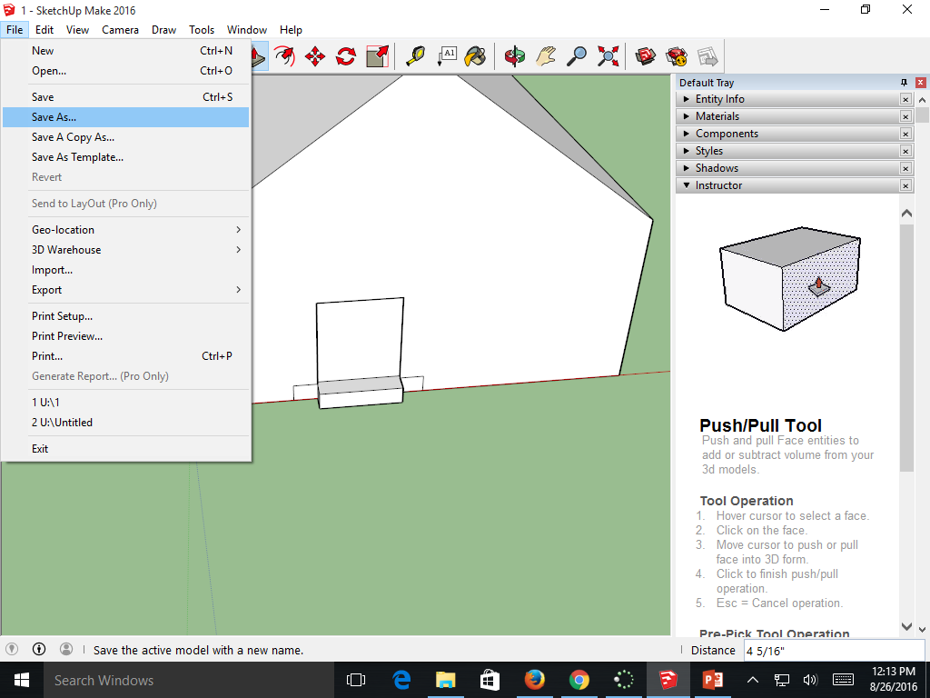
Save your project
Always save your model first

Slide 3
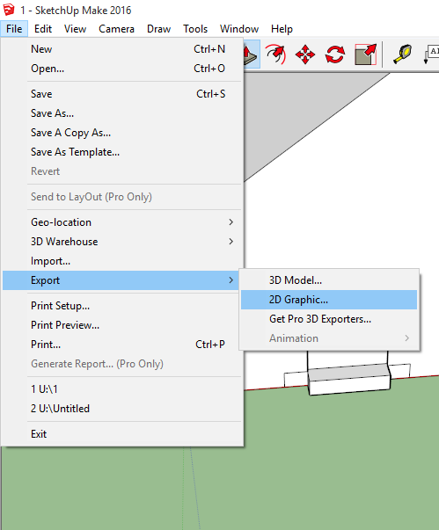
Exporting
Go to File, then Export, 2D Graphic

Slide 4
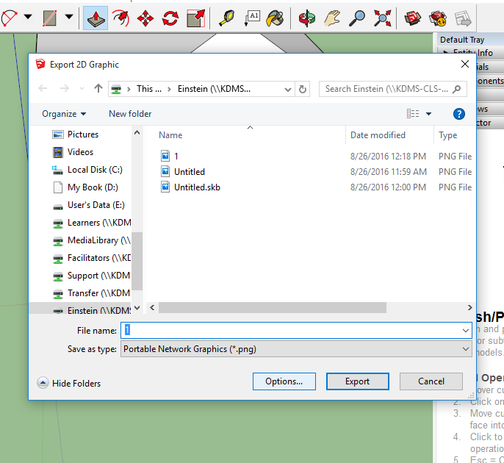
Save it as a .png file

Slide 5
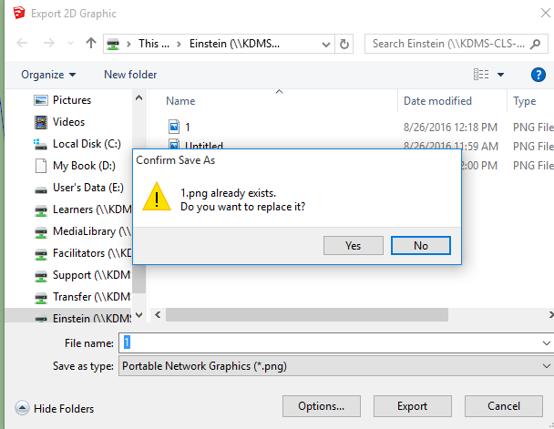
Go back and hit File—Export—2D Graphic --- Save again.
It will tell you the file already exists,
And if you want to replace it.
Hit YES. It will then save it as an .SKB
File. Open your learners drive and make
Sure you saved to your drive.

Slide 6
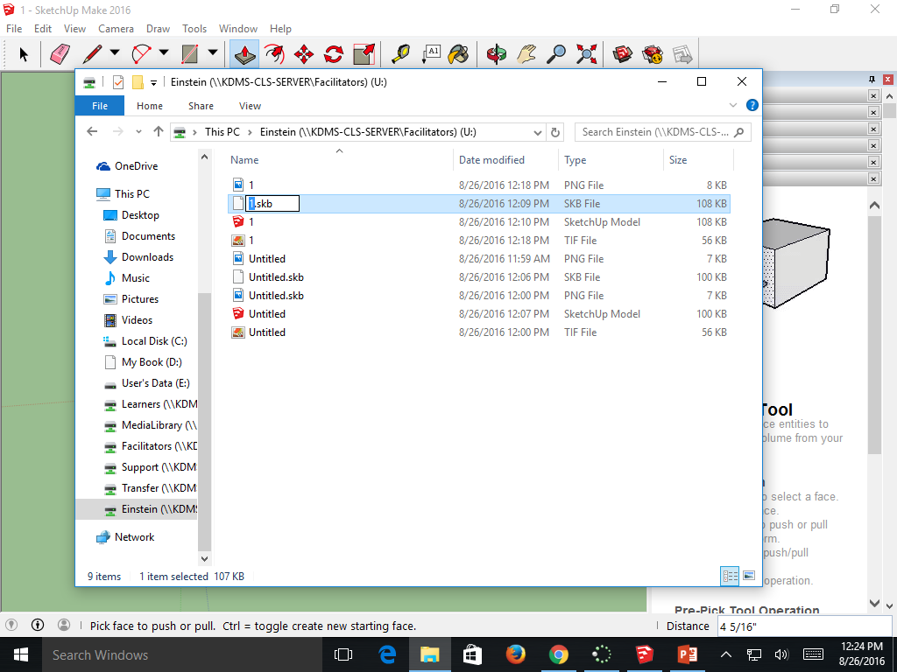
Copy the .SKB file and paste it into your Powerpoint

